Slide 1
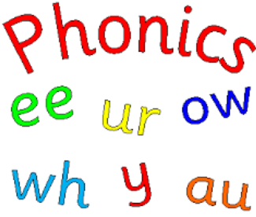
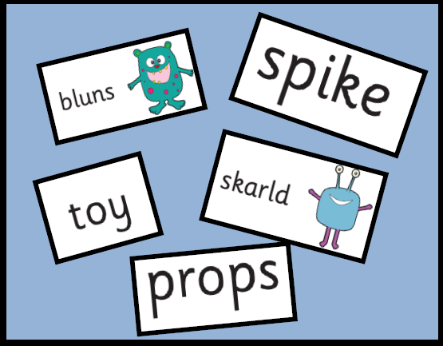
Landscore School Phonics Screening Check Meeting
March 2019

Slide 2
The Power of Phonics
Phonics is the key to your child becoming a fluent reader
The ability to read and write is a vital skill for all children, paving the way for an enjoyable and successful school experience.
Being able to read is the most important skill children will learn during their early schooling and has far-reaching implications for lifelong confidence and well-being.

Slide 3
Phonics Consists of:
Identifying sounds in spoken words
Recognising the common spellings of each sound
Blending sounds into words for reading
Segmenting words into sounds for spelling
Although there are 26 letters in the English alphabet, there are 44 speech sounds.

Slide 4
Some Definitions:
A Phoneme
This is the smallest unit of sound in a word
Children need to practise recognising the grapheme and saying the phoneme that it represents, e.g. t, ai, igh.
A grapheme
These are the letters that represent the phoneme.

Slide 5
Digraphs / Trigraphs
Digraph = 2 letters making one phoneme
e.g. sh, ee, th
Trigraph = 3 letters making one phoneme
e.g. igh, ear, air

Slide 6
Blending
Recognising the letter sounds in a written word, for example
c-u-p
and merging or ‘blending’ them in the order in which they are written to pronounce the word ‘cup’
Notes:
Capitalised title

Slide 7
Segmenting
‘Chopping up’ the word to spell it out
The opposite of blending
Identifying the individual sounds in a spoken word (e.g. h-i-m , s-t-or-k) and writing down letters for each sound (phoneme) to form the word him and stork.
Notes:
Capitalised title

Slide 8
Pronunciation of Sounds
Saying the sounds correctly with your child is extremely important
The way we say sound may well be different from when you were at school
We say the shortest form of the sounds, not with a ‘schwur’
- otherwise cat becomes cur- a - tur

Slide 9
Phonics learning is fun!
The children learn and practise their phonemes in lots of fun ways:
Sound talking and rhyming.
Playing games – table games or interactive games on the computer.
Using phoneme frames, “sound buttons” and whiteboards to spell words.
Sorting phonemes.
Making words with phonemes.
Being phoneme “detectives”.
Reading and writing sentences. Silly sentences are great fun!
Notes:
Sequence in lesson of revisit/revise, teach, practise, apply

Slide 10
Sound Mats
Phase 4: learning to blend the sounds

Slide 11
Landscore Sound Mat
We have combined the graphemes into the different phoneme boxes – same sound, different spelling.

Slide 12
What is the screening check?
The check is a national phonics test for all year one pupils and for those current year two pupils who did not meet the pass mark in the previous year.
It will take place the week beginning the 10th June.
Children will be given 40 words to read – 20 real words and 20 ‘alien’ words.
The test takes about 10 minutes and will be done with Miss Coney 1:1 in a quiet room.

Slide 13
Example of test:

Slide 14
Sesquipedalianism
(Meaning: to use very long and obscure words!)

Slide 15
Learning strategies
dentist
d/ e/ n /t /i/ s/ t – by the time they have segmented each phoneme the children forget the first few phonemes and are not able to blend the word.
fighter
f /igh/ t/ er - children need to be able to recognise the grapheme in the word.
blook
b/ l/ oo /k- a child will look for the real word and say ‘book’

Slide 16
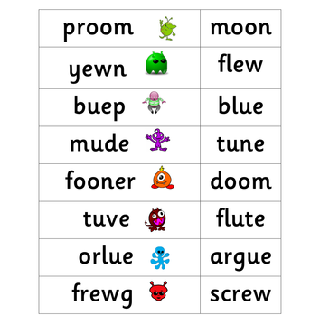
Try these!

Slide 17
How can you help?
Play lots of sound and listening games with your child.
Read as much as possible to and with your child.
Encourage and praise – get them to have a ‘good guess’.
If your child is struggling to decode a word, help them by encouraging them to say each sound in the word.
Blend the sounds by pointing to each one, e.g. /c/ in cat, /p/ in pat, /ng/ in sing, /ee/ in been. Next move your finger under the whole word as you say it.
Discuss the meaning of words if your child does not know what they have read.

Slide 18
How can you help?
Using sound mat
Can you find an object with this sound/grapheme? E.g. /ou/ - mouse, spout, sprout
Can you find this sound on the mat?
Which sounds do you need to make the word: dog, crown, sprout, escape?
Which grapheme do you need for the word_________? e.g. flote, flowt, floet or float?

Slide 19
In your pack, you will find sheets that look like this. Children should be able to read the word to you and then you can discuss if it is real or alien. They need to be able to recognise the grapheme in the word: Paul

Slide 20
Remember: Phonics is not the only thing needed to become a fluent reader
Please continue to read with your child each night and encourage them to:
Sound out
Re-read to check it makes sense.
Use pictures for clues.
Ask questions and talk about the book.
And most importantly ENJOY READING!

Slide 21
Discussion and questions

